Slide 1
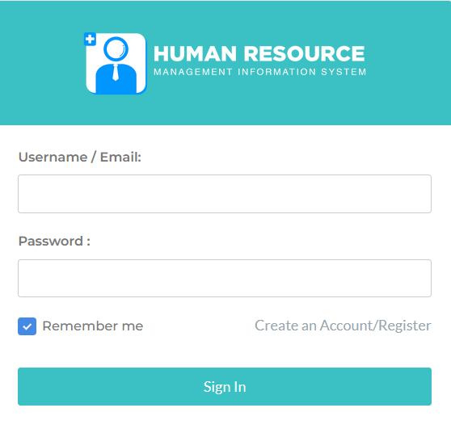
HRIS Applicant’s Module
01

Slide 2
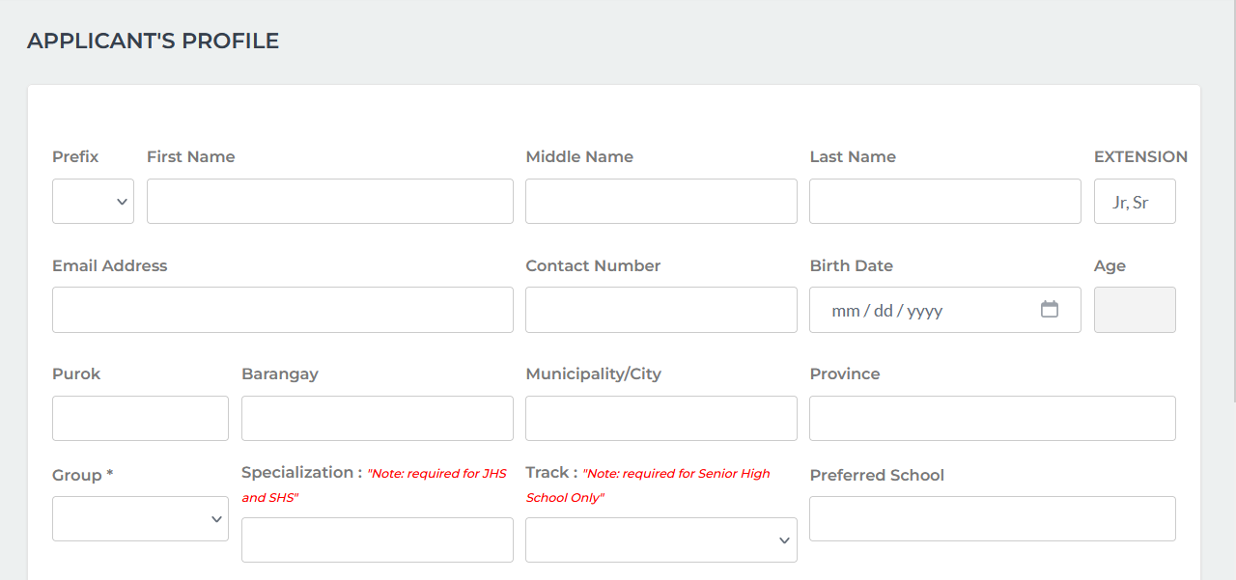

Step 1: Create an Account
Using your browser, visit https://hris.depeddavor.com
Click
Check your email for the login credentials.

Slide 3
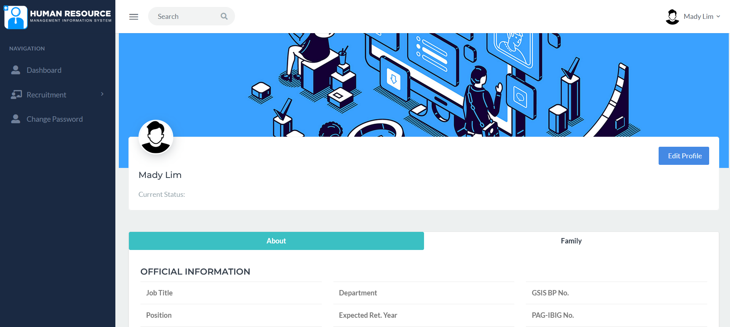
Step 2: Update Your Profile
Login to the https://hris.depeddavor.com using the credentials sent via registered email. Click Edit Profile.

Slide 4
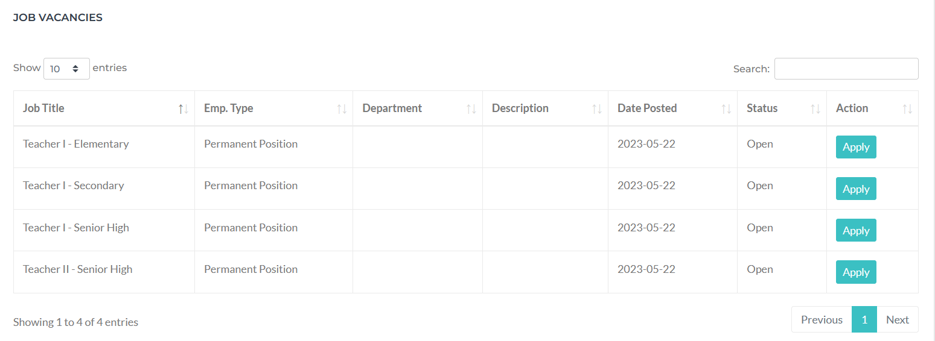
Step 3: Submit an Application
From the Recruitment menu, click Job Vacancies.
Click the Apply button for the Job Title you intend to apply.

Slide 5
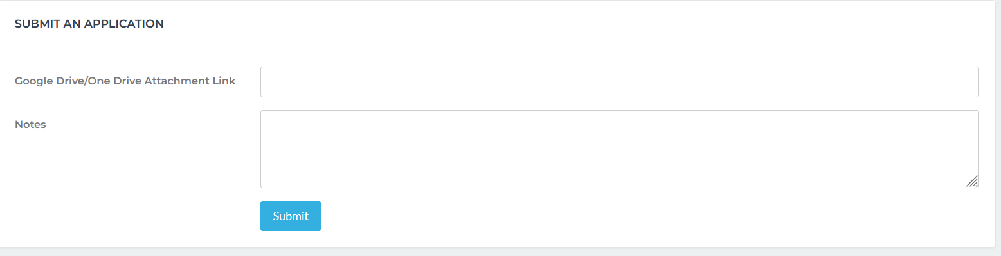
Step 3: Submit an Application
Attach the link of the uploaded scan copy of your application documents.
Click the Submit button.

